Slide 1

From the individual to the social: The promise (and problems) of a public health approach to distress
Dave Harper
University of East London

Slide 2


Harper, D. (1993). The personal and the political: a rant against fragmentation. Clinical Psychology Forum, 62, 23.
Fed up with having been lied to by a syndicate of cheating, money-grabbing bastards known only as the Conservative party. What sort of persons support these people?
You can’t do a hell of a lot without money. And you need a job to get money but there are no jobs. I call it the poverty trap and nobody with money gives a damn.
Plus ça change?

Slide 3
The inexorable rise of individualised ‘technical’ interventions

Slide 4
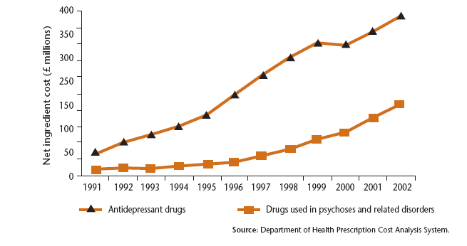
Increasing expenditure on medication
(from Social Exclusion Unit, 2004)
For info: UK population increased by approx 3% between 1991-2001

Slide 5
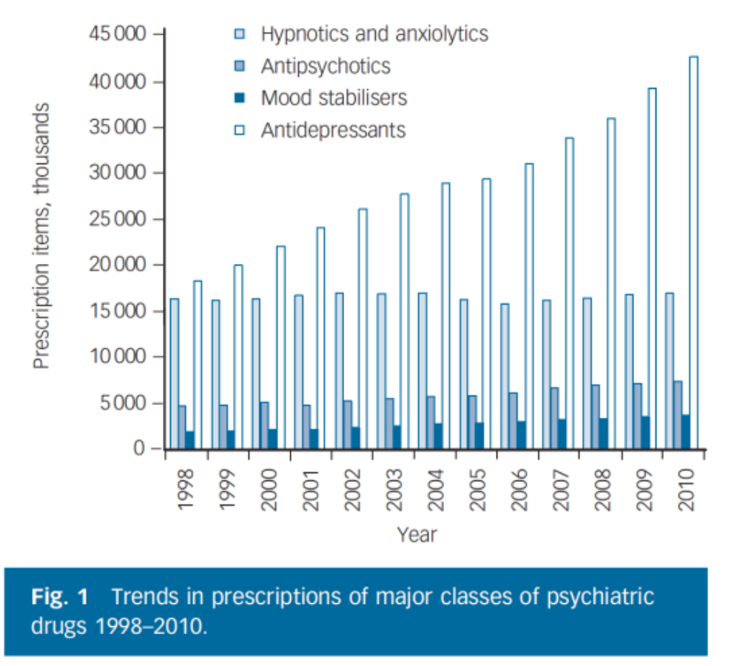
Prescription rates continue to rise in 2000s (Ilyas & Moncrieff, 2012)
For info: UK population increased by 5.6% between 2001-2011

Slide 6
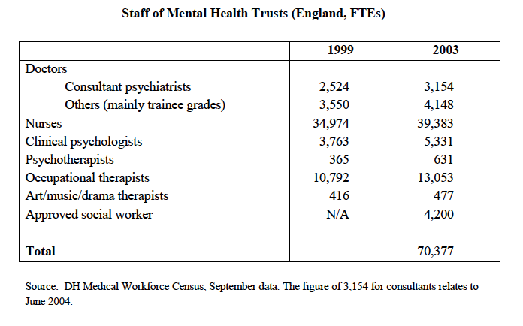
Increasing numbers of mental health professionals

Slide 7
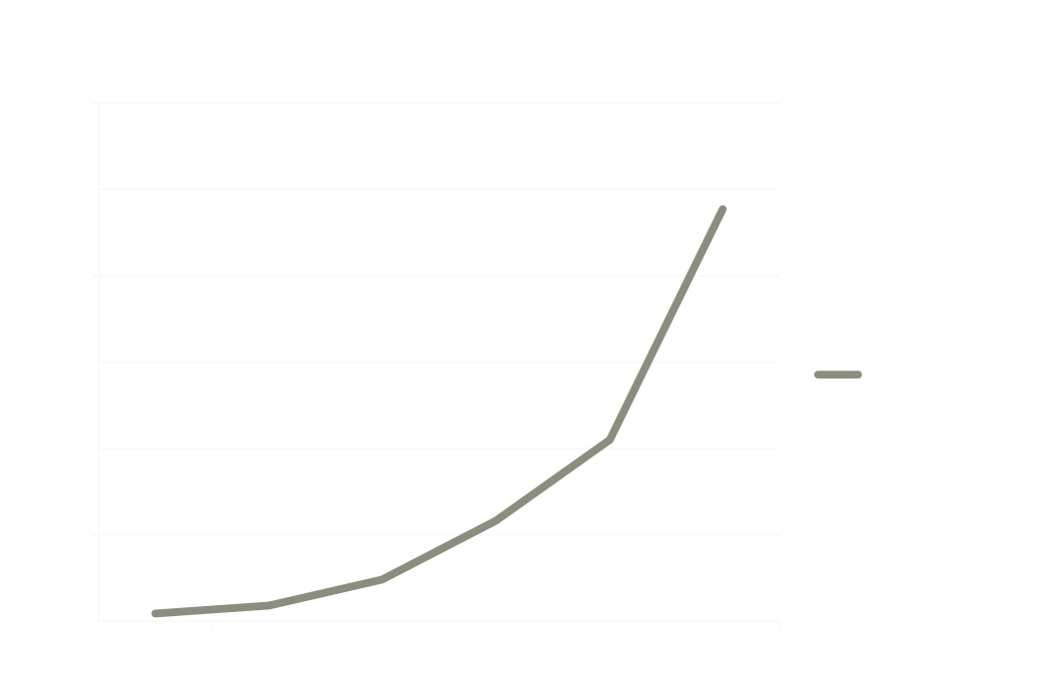
Increasing numbers of clinical psychologists

Slide 8
Limitations of individual interventions

Slide 9
History of critique by US social and community psychologists like Seymour Sarason and George Albee and critical and community psychologists in the UK
  The effectiveness of psychotherapy for most of those who receive it is no longer in doubt but neither is the fact that psychotherapy can only reach a small portion of society. (Humphreys, 1996, p.193)
  Psychotherapy lured the field into an overemphasis on individual psychology and individual-level treatment as the best approach to society’s ills and an under-emphasis on preventive interventions and socio-community-level conceptualizations of human behaviour. (Humphreys, 1996, p.193)

Slide 10


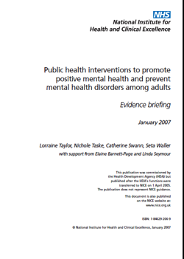
Legitimising a social approach to distress

Slide 11
What can we learn from public health?
John Snow and the 1854 Broad Street
cholera outbreak
Liverpool Sanitary Act of 1846 prohibited the inhabiting of cellars and the building of houses without drains.
Dr William Henry Duncan was the country’s first Medical Officer of Health.
He worked closely with engineers and public officials and 180 miles of sewers and drains were built in ten years

Slide 12
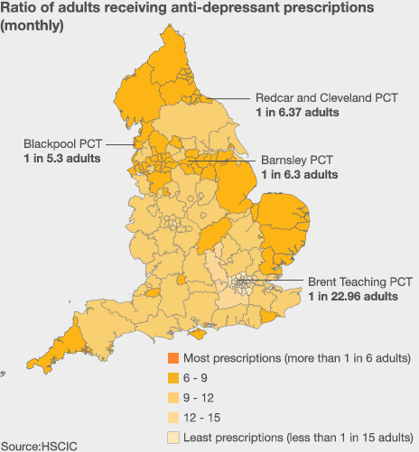
http://www.bbc.co.uk/news/uk-23553897
The social patterning of distress
British Attitudes Survey:
  31% of the poorest quarter of
  the population (household
  income less than £12,000) had
  used medication, compared with
  only 17% of the richest quarter
  (household income of £38,000
  or more)
  Anderson et al (2009)

Slide 13
A primary prevention approach
What are the equivalents to Snow and Duncan’s work in relation to mental health?
  Mapping distress
  Clarifying causes
  Seeking to change causes of distress
  Working with a wide range of agencies and planning infrastructure

Slide 14
Micro: Mapping pathways between social factors and distress associated with psychotic experiences
Childhood sexual abuse has been particularly implicated in auditory–verbal hallucinations, and attachment-disrupting events (e.g. neglect, being brought up in an institution) may have particular potency for the development of paranoid symptoms
Bentall et al. (2014)

Slide 15
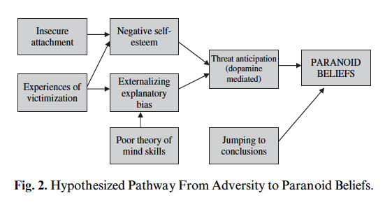
Bentall & Fernyhough (2008)

Slide 16
Example: social inequality and paranoia (Cromby & Harper, 2009)
Phenomenology of low status, low pay, long hours, job insecurity or unemployment
> Produces feelings such as anxiety, misery, despair, anger and shame (Charlesworth, 1999)
> The material need to persist in coping with both these feelings and circumstances may encourage tendencies to disavowal or bypassing

Slide 17
> These feelings and their consequences may impact negatively upon family life and relationships
> Some people may come to favour interactional styles that are relatively hostile, distant, controlling and emotionally guarded (esp as parents)
> Less time and ability to bestow on others compensatory affection, love and reassurance which might counteract and insulate against the negative feelings generated by social world
> Angry or hostile discourses can boost status, ward off threats and construct tough personae that make attacks and exploitation less likely

Slide 18
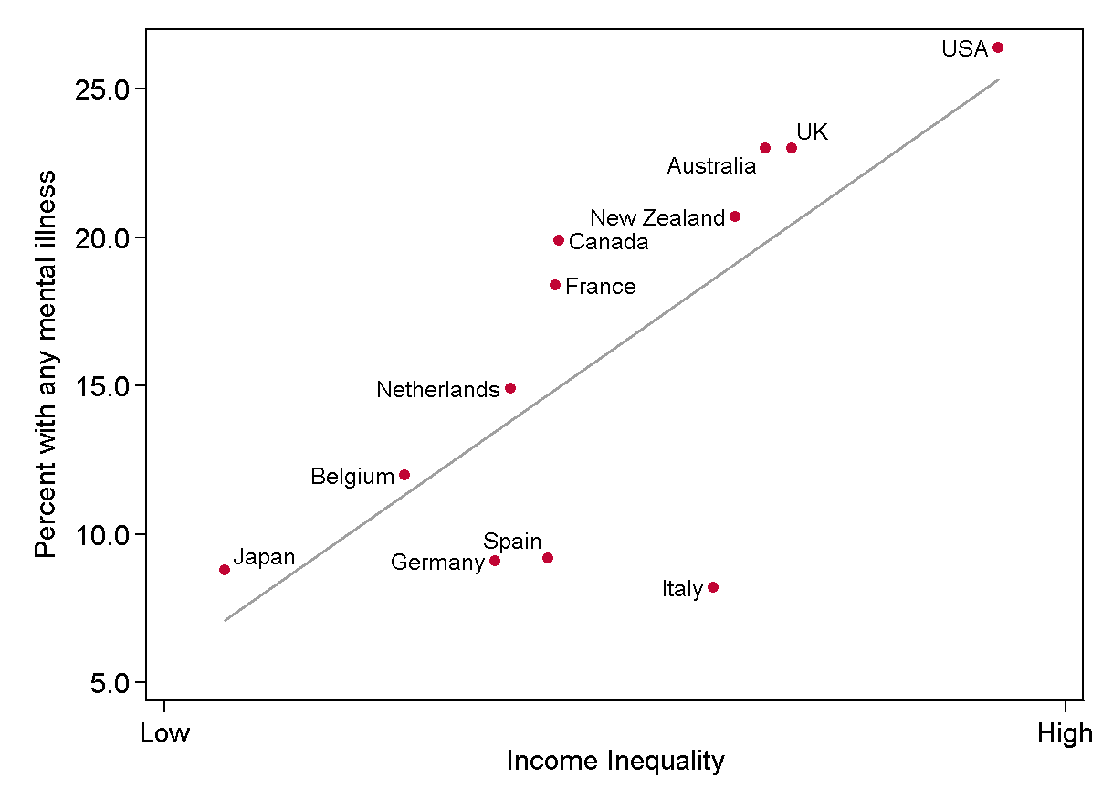
Macro: Addressing social inequality

Slide 19
Limitations of a public health approach
Possible to influence work of health and social care professions but other levers (economic policy etc) may be left out of the equation
Cuts to local authorities
Danger of an individualised asset-based salutogenic approach (Friedli, 2013)
Danger of notions of vulnerability – need to focus on the systems, people and processes that do the damage (Boyle, 2003)

Slide 20
Can lead to a more medicalised approach
  E.g. Dame Sally Davies CMO for England in 2013 criticised conceptual confusion and poor evidence base of wellbeing approaches
  But she didn’t apply that critique to psychiatric diagnoses
Many PH approaches to mental health use diagnostic categories uncritically (e.g. ‘psychiatric literacy’)

Slide 21
Reliability and validity problems
Diagnostic thresholds not based on general population norms:
  Van Os et al. (2000): 3.3% of sample of 7,000 Dutch people had 'true' delusions whilst 8.7% had delusions not associated with distress or need for intervention
  15% of US population meet criteria for personality disorder
  Causes iatrogenic epidemics (eg ADHD changes in DSM-IV in 1994)

Slide 22
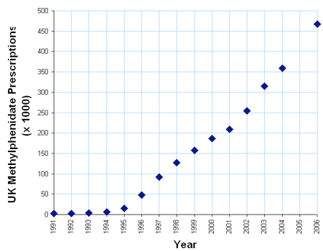

Slide 23
Cluster analyses of population-wide symptom surveys do not map onto psychiatric diagnostic categories
Heterogeneity of categories (two people with same diagnosis can present totally different profiles of symptoms)
High co-morbidity of categories (eg over 50% of those with diagnosis of depression also meet criteria for anxiety: Hirschfield, 2001)

Slide 24
Diagnosis of schizophrenia does not predict prognosis, outcome or treatment (Bentall, 2004)
Allen Frances (Chair of the APA DSM-IV committee)
  DSM-5 announced it would accept agreements among raters that were sometimes barely better than two monkeys throwing darts at a diagnostic board. (Frances, 2013, p.175)
Of course, even if raters can agree it does not mean the construct exists in the real world (e.g. Santa Claus, unicorns etc)

Slide 25
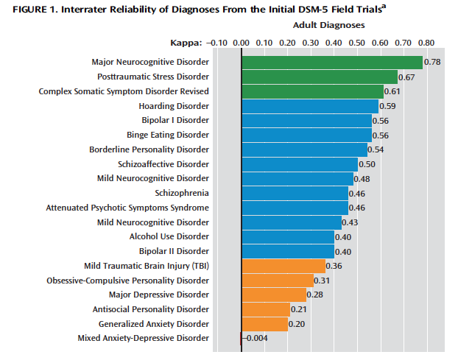

Source: Freedman et al (2013) -- Editorial in American Journal of Psychiatry, January.

Slide 26
So, what can we do?
Remember that change is possible: water sanitation in 19th century; smoking; changing attitudes to sexuality etc
We need to influence public opinion at grass roots level to introduce radical change to address structural causes of distress (e.g. 1945 general election)
Speak truth to power about the sources of distress and influence the media agenda (blogs, radio phone-ins etc)
Facilitate community-based approaches (e.g. peer support networks etc)

Slide 27
Building support to address inequality as a public health issue
Joseph Rowntree Trust:
Focus on specifics not just ‘poverty’ in general
Use variety of media and target specific groups
Facts & real life examples
Identify clear solutions
Not making audience feel guilty – focus on how change will benefit most and on successes rather than simply hardship

Slide 28
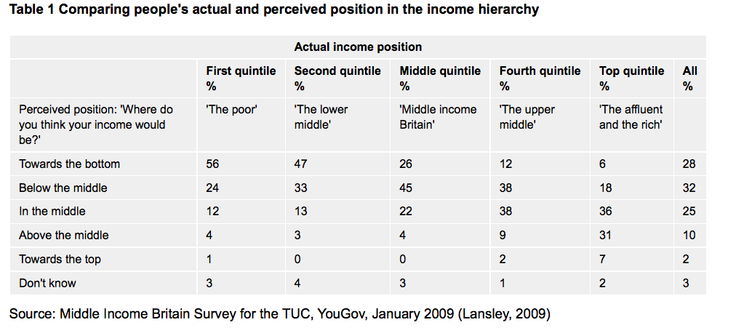
Addressing myths & misperceptions about poverty

Slide 29
Smail, D. (1996). J. Richard Marshall. Clinical Psychology Forum, 95, 14-17.
I just know that the biological approach to psychological distress is bollocks ... I personally just can't be bothered to argue about it any more with a new generation. I don't care what 'new evidence' is supposedly advanced: I've seen it all before. Fatuous, self-important professors in white coats staring at computer images of people's brain waves, etc., expounding their half-baked ideas to mesmerized television pundits who swallow the story whole and breathlessly reproduce it for the viewing millions. It's all crap and I'm too old and too tired to be doing with it ... But that is not the attitude! ... These ideas are dangerous and destructive and they have to be dealt with. Smail (1996, p.16)

Slide 30

d.harper@uel.ac.uk

