Slide 1
Working across boundaries in services for children & families
Power, Interest and Psychology: developing David Smail’s ideas
Iyabo Fatimilehin
13th November 2015

Slide 2
Crossing Boundaries
Service contexts
Cultural contexts
  Professional contexts
Personal values
Economic & political influences

Slide 3
Service Contexts
Clinics vs homes
Collaborative & community based
‘Hard to reach’ people & communities
‘Hard to reach’ professionals & services
Power dynamics

Slide 4
Cultural Contexts
Personal identity & experiences
Cultural diversity & human experience
Professional culture
  Therapy
  Individualised understandings of distress

Slide 5
Impact of Personal Values
From frying pan into the fire
Impress of power & court proceedings

Slide 6
Just Psychology CIC
Emphasis on cultural diversity, cultural competence & social justice
Addresses effects and causes of poor psychological health, improve mental well-being
Vision - Full participation of all Black and minority ethnic children and their families in an equal and fair society through the achievement of a significant improvement in psychological health and mental well being, and the prevention of problems with mental health.

Slide 7
Just Psychology
Social enterprise – a credible & sustainable alternative?
Principles & values
Therapy, assessment, training, community development, family group conferences

Slide 8
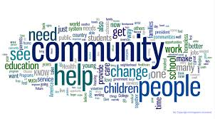




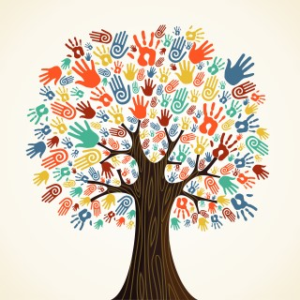




Who am I?

Slide 9
Contact Us:
www.justpsychology.co.uk
info@justpsychology.co.uk
0161 262 1622

