Slide 1
Speaking our minds as clinical psychologists
Birmingham 2015
Dr Lucy Johnstone
Consultant Clinical Psychologist
Lucy.Johnstone@wales.nhs.uk
@clinpsychLucy
Copyright Lucy Johnstone: please do not reproduce without permission

Slide 2
Outline of talk
The wider context: threats to prevailing paradigm in psychiatry
How clinical psychologists do (and don’t) rise to the challenge
Reflections on our professional and ethical responsibilities

Slide 3
‘I just know that the biological approach to psychological distress is bollocks.’
(David Smail, 1996, Clinical Psychology Forum)

Slide 4
‘There is no definition of a mental disorder. I mean, you just can’t define it. It’s bullshit’ (Dr Allen Frances, chair of DSM IV committee)
http://www.wired.com/magazine/2010/12/ff_dsmv/

Slide 5
The DSM 5 disaster
‘There is no reason to believe that DSM-5 is safe or scientifically sound…..The science simply isn’t there now……A research dead end.’ Professor Allen Frances, Chair of DSM IV Task Force
Dr Steven Hyman, former NIMH director : DSM is 'totally wrong, an absolute scientific nightmare.'
Dr Thomas Insel, former director of NIMH: 'Patients….. deserve better…..The weakness is its lack of validity.’
Dr David Kupfer, chair of the DSM-5 committee: ‘We've been telling patients for several decades that we are waiting for biomarkers. We're still waiting.’
From now on, ‘NIMH will be re-orienting its research away from DSM categories’ (Insel, 2013.)

Slide 6
‘Western psychiatry is in crisis’
‘Western psychiatry is in crisis.’
‘…..the simplistic and imposed application of….reductionist science’ which can ‘encroach on basic human rights.’
(Mental Health Europe 2013, a large umbrella organisation representing both professionals and service users.)
‘Some observers have questioned whether the psychiatrist is an endangered species…Urgent action is required… to ensure the future of psychiatry as a profession’ (Oyebode and Humphrys, British Journal of Psychiatry, 2011)

Slide 7
Why is the diagnosis debate so important?
Without a valid classification system, psychiatry would become ‘…..something very hard to justify or defend – a medical specialty that does not treat medical illnesses’ (Breggin 1993)
‘If it becomes apparent that the information obtained by testing disease theories is incoherent, we may eventually jettison particular disease constructs….The disease constructs in psychiatry may be approaching this point.’
(Bebbington: Psychological Medicine October 2014)

Slide 8
In ‘Anatomy of an epidemic’ (2010) award-winning US science journalist Robert Whitaker presents compelling evidence that all psychiatric drugs increase disability over the long term.
‘This is the story of a medical puzzle… It tells of a hidden epidemic that is diminishing the lives of millions of Americans, including a rapidly increasing number of children. The epidemic has grown in size and scope over the past five decades and now disables 850 adults and 250 children every day…Now here is the puzzle. As a society we have come to understand that psychiatry has made great progress in treating mental illness over the past 50 years….In 2007 we spent $25 billion on anti depressants and anti psychotics….As the psychopharmacology revolution has unfolded, the number of disabled mentally ill has skyrocketed.’
Maudsley debate May 2015: ‘This house believes that long-term use of psychiatric medication does more harm than good.’ See BMJ editorial 2015, 349

Slide 9
The Recovery model
Recovery themes: finding a new sense of -
Connectedness (including support from others and feeling part of the community); hope and optimism about the future (including belief that recovery is possible); identity (including overcoming stigma); finding meaning in life (including the experience of ‘mental illness’); and empowerment (including taking personal responsibility, focusing on strengths, and taking control of one’s life) (Leamy et al 2011)
Was this the consequence of the ‘illness’ or of the diagnosis?

Slide 10
Much evidence that ‘recovery’ is as much about overcoming the messages of the diagnosis and the effects of ‘treatment’ as it is about getting over an ‘illness.’
Leading members of the service user/survivor movement date their recovery from the moment they rejected their diagnoses
(Viv Lindow, Eleanor Longden, Ron Coleman, Rufus May, Jacqui Dillon, Rai Waddingham, Laura Delano, and many others.)

Slide 11
The ‘ACE’ (Adverse Childhood Experiences) studies
‘The most important studies you’ve never heard of’
17, 421 participants, 15 year follow-up, over 50 papers
10 types of childhood adversity (sexual, verbal or physical abuse; parent with diagnosis of ‘mental illness’, domestic violence, family member in prison, loss of a parent; emotional or physical neglect).
Strong graded relationship between high ACE scores and higher rates of mental and physical illhealth, behavioural and social problems.

Slide 12
Higher ACE scores predict greater incidence of depression, suicide, ‘psychosis’, PTSD, drug use, criminal behaviour, heart disease, cancer, STDs, lung disease, liver disease, smoking, obesity, diabetes, poor educational and work performance, homelessness, prostitution, unemployment, and early death.
ACEs act in a cumulative and synergistic way to cause ‘complex adult psychopathology.’
www.acestoohigh.com

Slide 13
‘First do no harm.’ Ethics column in Clinical Psychology Forum September 2014
‘It’s hard to imagine such a record of harms could be tolerated in any other branch of healthcare, and it is hard to imagine how an ethical perspective can tolerate our use of the failed medical model paradigm in mental health any longer. It’s time to reach beyond diagnostic dependence.’
Dr Sami Timimi, co-chair of Critical Psychiatry Network

Slide 14
So….what are clinical psychologists doing about all this?
‘We work in service systems largely based on a theoretical model which is more or less completely incompatible with ours. Heaven knows, we have bent over backwards to disguise this fact, to fit in, to appease, not to give offence. We have extensively adopted the language of medicine…we have described people in terms an extraordinary range of deficits…we have eagerly adopted models such as the biopsychosocial model or the stress-vulnerability model, which make it easy for genes and biology to remain privileged…. we have used the DSM framework to organise textbooks and much of our research and practice…. The medical model remains dominant; we are graciously allowed to continue research and practice, provided we don’t say or do anything too threatening…. Why are we so timid in taking the lead?...Which are the truths we are still not speaking?’
Mary Boyle, Clinical Psychology Forum 2006, 168, 4-6

Slide 15
‘Understanding “Customer needs” of Clinical Psychology Services’ survey 2007
Views about clinical psychologists from commissioners, managers and other clinicians
Strengths: Research knowledge, complex cases, range of treatment modalities, supporting other professionals
Limitations: Relatively expensive, not integrated into teams,
‘aloof, precious about their roles and elitist’

Slide 16
‘We see it as essential that psychologists…have a critical and questioning perspective on the values and practice that dominate mental health services and psychology…Whilst we believe that our profession can contribute to obscuring and individualising people’s experiences, we also believe it has much to offer in terms of explanations of human despair’ Coles, Diamond and Keenan 2009.
‘…Questions about how we respond to human suffering are not simply ones of science or evidence, though that may be a part of it. They are ultimately moral, ethical and political issues on which we all need to take a stand.’
Chapter in ‘Critical psychiatry: The limits of madness’ ed Duncan Double, Palgrave Macmillan 2006

Slide 17
‘An overwhelming amount of evidence tells us that as clinical psychologists we cannot afford to ignore the context of social inequality and injustice in our work, for scientific as well as ethical reasons. This will inevitable also involve us in challenging, not colluding with, some of the core tenets of biomedical psychiatry. In this way we will be facing ethical dilemmas head on, wherever we work, and fulfilling our moral and professional responsibilities as clinical psychologists.’
Chapter on ‘The clinical psychologist’ in Mental Health Ethics: The human context’ ed Phil Barker, Routledge 2011

Slide 18
So what stops us from speaking our minds?
We have status, knowledge, extensive training, self-confidence, good pay… but are we too comfortable? Do we have too much to lose? Are we (or some of us) even aware of the problem?
The profession’s ‘ambivalent position towards psychiatry – wanting full professional independence but, at times of selective convenience, co-opting a medical knowledge base’ (Pilgrim, 2000)

Slide 19
The challenge/compromise/avoid dilemma…..
….in relation to diagnosis, the biomedical model, the harms caused by psychiatric medication, IAPT, the role of social inequality and deprivation, working within psychiatry vs outside it….and many other issues.
‘As a clinical psychologist, one would have to be phenomenally incorruptible not to experience just a tiny frisson of interest at contemplating such inducements as those dangled by Layard before one’s eyes….’
‘….the kind of bureaucratised “science” peddled by NICE is exactly the kind of thing a healthy and independent clinical psychology, in charge of its own soul, would criticise, not endorse.’

Slide 20
The response of senior psychologists to the offer: ‘This is almost classic in its near-phobic avoidance of considering anything that could possibly be considered as speaking the truth about the world.’
David Smail, ‘Is clinical psychology selling its soul (again)?’ (2006)
There are no simple answers. Individual clinical psychologists will choose different solutions at different times and in different situations. Compromise will almost inevitably shade over into collusion at times.

Slide 21
Perhaps the only guiding principle is that we should be informed, reflective and honest about these ethical dilemmas rather than pretending they do not exist.
And we need to be honest about the personal and professional impact of speaking out….. Sometimes there is a high price to pay.

Slide 22
But sometimes we do rise to the challenge! Some recent examples….
Useful to bear in mind:
‘First they ignore you, then they laugh at you, then they fight you, then you win.’
Mahatma Gandhi

Slide 23
DCP/BPS consultation response 2011
‘Clients and the general public are negatively affected by the continued and continuous medicalisation of their natural and normal responses to their experiences; responses which undoubtedly have distressing consequences which demand helping responses, but which do not reflect illnesses so much as normal individual variation….
…..The putative diagnoses presented in DSM-V are clearly based largely on social norms, with 'symptoms' that all rely on subjective judgments, with few confirmatory physical 'signs' or evidence of biological causation. The criteria are not value-free, but rather reflect current normative social expectations…..
… [taxonomic] systems such as this are based on identifying problems as located within individuals. This misses the relational context of problems and the undeniable social causation of many such problems.’

Slide 24
DCP Position Statement on Classification 2013
‘The DCP is of the view that it is timely and appropriate to affirm publically that the current classification system as outlined in DSM and ICD, in respect of the functional psychiatric diagnoses, has significant conceptual and empirical limitations and there is thus a need for a paradigm shift in classification in relation to these diagnoses, towards one which is no longer based on a “disease” model.’
International and national coverage (eg The Observer 12.5.13 ‘Medicine’s big new battleground’)

Slide 25
As you can see….we are winning!
‘The groups… who are actually proud to identify themselves as “anti-psychiatry”…They are, to my mind, misguided and misleading idealogues and self-promoters who are spreading scientific anarchy’ (Jeffrey Leiberman, former APA President, 20.5.13)
‘…extremist posturing by the BPS’ (Dr Allen Frances )

Slide 26
Shared theme of recent DCP documents
‘Services should not insist that all service users see their problems as an “illness” and take medication’ (‘Understanding Bipolar disorder’ 2010)
http://shop.bps.org.uk/understanding-bipolar-disorder.html
‘Understanding Psychosis’ 2014
Free download from www.understandingpsychosis.net
‘Hearing voices or feeling paranoid are common experiences which can often be a reaction to trauma, abuse or deprivation. Calling them symptoms of mental illness, psychosis or schizophrenia is only one way of thinking about them, with advantages and disadvantages’ (p.6)

Slide 27
We’re obviously winning here too!
‘…exploits, disrespects, silences and marginalises service users..
Understanding Psychosis should be seen as a cruel hoax perpetrated against more typical severely disturbed mental health service users, their family, and policymakers.’
‘And while the psychologists lobby for a greater piece of the treatment pie….slanting to their own "narrow professional self-interests" ….the suffering of those with the most serious of mental health problems and issues -- real illnesses -- continues.’
A fierce debate at https://www.psychologytoday.com/blog/psych-unseen/201503/psychosis-sucks

Slide 28
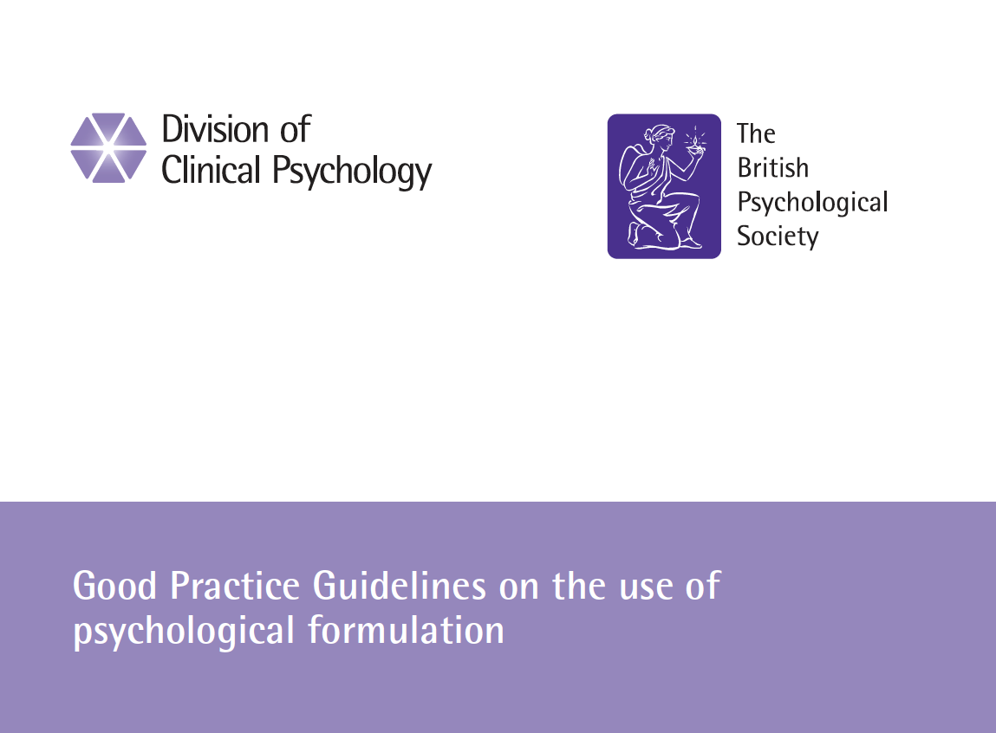
Good practice guidelines on the use of psychological formulation 2011
Best practice formulation …. ‘Is not premised on a functional psychiatric diagnosis (eg schizophrenia, personality disorder)’ (p.20)

Slide 29
Some best practice formulation principles
‘Levels of distress among communities need to be understood less in terms of individual pathology and more as a response to relative deprivation and social injustice’ (WHO, 2009.)
‘If Britain became as equal as the four most equal societies (Japan, Norway, Sweden and Finland), mental illness might be more than halved’ (Wilkinson and Pickett, 2009.)
‘Interventions will be ineffective if wider causal factors are located at an individual level, thus pathologising the service user and increasing their sense of hopelessness’ (p. 20.)
Have a critical awareness of the wider societal context within which formulating takes place, even if this dimension is not explicitly included in every formulation (p.20.)

Slide 30
Alternative models of mental distress
Editorial in the British Journal of Psychiatry
‘After decades of ignoring the…..effects of negative events in childhood, researchers have recently established that a broad range of adverse childhood events are significant risk factors for most mental health problems, including psychosis….The implications of our having finally taken seriously the causal role of childhood adversity are profound’ (Read and Bentall, 2012)

Slide 31
Childhood trauma, abuse and neglect is strongly linked to all psychiatric breakdown, including ‘psychosis’
Evidence of a dose-dependent relationship between the severity, number, and number of types of traumatic episodes, and the likelihood of psychosis (People abused as children are 9.3 times more likely to develop psychosis; risk rises to 48 times for the severest abuse (Janssen et al, 2004); people who have experienced 3 kinds of abuse were 18 times more likely to be psychotic; 5 types of abuse = 193 times more likely (Shevlin et al, 2007.)
The causal relationship holds in prospective studies and after controlling for gender, ethnicity, education, substance abuse, etc.
The content of delusions is often closely related to actual experiences of abuse (Read et al, 2005)

Slide 32
The trauma-informed model
The emerging ‘trauma-informed’ model recognises the causal role of trauma and adversity in all human systems organisations (psychiatric, addictions, criminal justice, social care.)
It also acknowledges that many interventions may be re-traumatising.
Psychiatric ‘symptoms’ are in fact evolved survival strategies – adaptive at the time but they have outlived their usefulness
A 3 stage approach (education and stabilisation; trauma processing; reconnecting to one’s life) underpins all therapeutic work
(Dillon, Johnstone and Longden 2012)

Slide 33
An emerging evidence base from neuroscience and attachment theory shows how trauma creates a state of high arousal when stems from the overwhelming of coping mechanisms in response to extreme stress. ‘Complex’ trauma is cumulative, synergistic and interpersonally generated. Early interactions with caregivers are crucial in later relationship formation and emotional regulation. Trauma memories are processed differently, unintegrated from autobiographical narrative, and not ‘labelled’ with time and place. Dissociative responses to extreme stress, when it is not possible to fight or flee, include hearing voices, panic attacks, mood swings, unusual beliefs, flashbacks and so on. ‘Symptoms’ are best understood as survival strategies, necessary at the time but not adaptive in present circumstances. A trauma-informed environment seeks to minimise triggering and establish safety across all areas of service delivery, on a cross-diagnostic basis (including addictions.) www.asca.org.au

Slide 34
Trauma-informed formulation
Considers the possible role of trauma and abuse
Considers possible role of services in compounding the difficulties
‘…..the potentially traumatising effects of medical and psychiatric interventions’ (p.14)
Trauma-informed formulations can help us to make sense of people’s distress, to bear witness to survivors’ stories, and to develop a shared framework for recovery

Slide 35
The meta-message of a best practice psychological formulation is:
‘You are experiencing a normal reaction to abnormal circumstances’
‘Anyone else who had been through the same events might well have ended up reacting in the same way’
A simple but radical and empowering message in the context of the dominance of the biomedical model of emotional distress
BUT – formulation is only one kind of narrative, with a certain amount of recognition and credibility within services. There are many others.

Slide 36
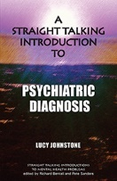

Slide 37
‘If the authors of the diagnostic manuals are admitting that psychiatric diagnoses are not supported by evidence, then no one should be forced to accept them. If many mental health workers are openly questioning diagnosis and saying we need a different and better system, then service users and carers should be allowed to do so too. This book is about choice. It is about giving people the information to make up their own minds, and exploring alternatives for those who wish to do so.’
The radical alternative to psychiatric diagnosis: listening to people’s stories.

Slide 38
An example of some relatively small but important changes….
Poor mental and physical health is recognised as a cause and consequence of social deprivation and inequality across Cwm Taf, which is the most deprived Health Board in Wales. 13% of the population is in contact with mental health services – the highest proportion in Wales. Localities like Merthyr Tydfil are recognised as amongst the most deprived in the UK.
  The majority of service users have a histories of multiple traumas in childhood and adulthood, usually compounded by poverty, social exclusion, and physical disability.

Slide 39
Over the last five years……
Regular team formulation meetings facilitated by psychologists are now running in:
All 5 CMHTS
Both AO teams
Rehab unit and wards
Inpatient wards
Formulations are trauma-informed
A one day conference in 2013 led to management recognition of the importance of adopting a trauma-informed perspective in the work of the Mental Health Directorate.

Slide 40
‘Stabilisation packs’ with psychoeducational material about the impact of trauma and emotional regulation skills are in regular use in all teams
Stabilisation groups piloted and due to be rolled out in all 4 localities
Training on disclosure and trauma-informed perspectives has been delivered to junior doctors, CMHTs and other teams
A rolling programme of sexual abuse survivor groups for women, delivered by a multi-disciplinary staff group, runs across all 4 localities
See free download of this month’s Clinical Psychology Forum at
www.bps.org.uk/cpf275

Slide 41
An opportunity to support this once-in-a-generation process
‘The knowledge of horrible events periodically intrudes into public awareness but is rarely retained for long….Clinicians know the privileged moment of insight when repressed ideas, feelings, and memories surface into consciousness….Victims who have been silenced begin to reveal their secrets…. Survivors challenge us to reconnect fragments, to reconstruct history, to make meaning of their present symptoms in the light of past events.’
Judith Herman (1992) ‘Trauma and recovery’

Slide 42
‘Sticking your neck out when it matters’…. It matters
‘I’ve always thought that psychologists and people in the helping professions generally can be pretty chicken-hearted when it comes to political issues. I should re-phrase that probably, it’s not because they are cowards, or they are anything reprehensible… it’s because people who come into this kind of job are on the whole menders and compromisers or believers in being nice to people…and I think when you get down to political activities with a small p those aren’t the most useful characteristics. You’ve certainly got to be able to be diplomatic, you’ve go to be able to see where the lines of influence run, but you’ve got to be prepared to stick your neck out when it matters.’
http://www.davidsmail.info/moloney.htm

Slide 43
Resources
Johnstone, L (2000) (2nd edn) Users and abusers of psychiatry: a critical look at psychiatric practice. Routledge
Johnstone, L and Dallos, R (2013) ‘Formulation in psychology and psychotherapy: making sense of people’s problems.’ 2nd edn Routledge
‘Medicine’s big new battle ground: does mental illness really exist?’ The Observer 12.5.13 http://www.theguardian.com/society/2013/may/12/medicine-dsm5-row-does-mental-illness-exist
Eleanor Longden, formerly diagnosed with schizophrenia and now a researcher and campaigner, gives an inspiring TED talk at http://www.ted.com/talks/eleanor_longden_the_voices_in_my_head.html
An equally inspiring talk by Jacqui Dillon, chair of the Hearing Voices Network in England http://www.youtube.com/watch?v=JHzHliy5yeQ
Talk by two psychologists from the Salomons course on ‘Is life a disease?’ http://www.youtube.com/watch?v=XQxORhtHiow
Blog on www.madinamerica.com/author/ljohnstone by Lucy Johnstone critiquing diagnosis and promoting formulation as an alternative, plus many other articles on the www.madinamerica.com site
Johnstone, L Diagnosis and formulation (2013) In (eds) J Cromby, D Harper and P Reavey Understanding mental health and distress: Beyond abnormal psychology Palgrave Macmillan

